Slide 1
Computer Organization and Assembly Language
Lecture # 1
Basic concepts

Slide 2
Overview
Welcome to COAL
Course Contents
Assembly-, Machine-, and High-Level Languages
Assembly Language Programming Tools
Programmer’s View of a Computer System
Data Representation

Slide 3
Welcome to COAL
Course Instructor:
Mehreen Javaid
Office: 304G (A block)
Email: mehreen.javaid@nu.edu.pk

Slide 4
Welcome to COAL
Office Hours: will be displayed on office door shortly
Google classroom: gms2erf
Lab Instructor:
Miss Amina Siddique

Slide 5
Class Particulars
Credit Hours:
4.0 [3+1]
Course Structure:
Two Lectures a week (Each of duration 1.5 hour).
One lab of 3-hr in each week

Slide 6

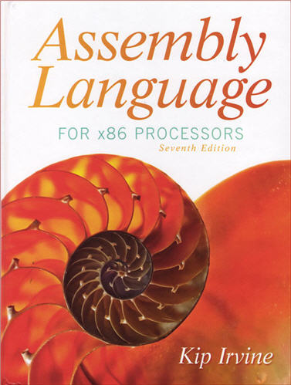
Text Books
Computer Organization and Architecture, William Stallings, 10th Edition
Kip Irvine: Assembly Language for x86 Processors 7th edition
Read the textbook!
Key for learning and obtaining a good grade

Slide 7
Tentative Grading Policy
Class
Assignments | 15%
Quizzes | 10%
Midterm Exam | 20%
Final Exam | 45%
Project | 10%

Slide 8
Grading Policy
There is simply no chance of extension in any of the deadline, what so ever
You can request for re-checking of any of your evaluation as per following rules;
Exams: Same day
Assignments: 2 days after handing-over
Quizzes: 2 days after handing over
Warning! After due time, request will not be considered even if it’s genuine.
Warning! Keep checking your FLEX regularly and don’t come in the end with bulk of queries in hand which you never presented earlier and now you are on the edge.

Slide 9
General Guidelines
Visit Google classroom course folder regularly for updates
No email submissions. Always remember that, you are putting your task in trash by yourself when you are emailing it.
Cheating cases are intolerable. You will be given negative marks for cheated stuff irrespective of the fact that, you were provider or the other one. Your cheating in exam will make it easy for you to step down from the Course with an ‘F’ grade. . . ☹
There will be no re-take of any evaluation if you haven’t informed earlier through a proper channel.
Quiz is inevitable so always, expect a One ☺

Slide 10
Some Important Questions to Ask
What is Assembly Language?
Why Learn Assembly Language?
What is Machine Language?
How is Assembly related to Machine Language?
What is an Assembler?
How is Assembly related to High-Level Language?
Is Assembly Language portable?

Slide 11
What is Assembly Language
Most of programs these days are written in high level languages for example C, C++, Java, python etc.
Writing these programs is much easier than machine code.
Assembly is a language which is close to machine language.
We all knows computer can understand only 0’s and 1’s
In assembly language we have different sets of instructions to perform different tasks (like each language has some syntax).
So in assembly each instruction or operation has some binary code.
For example
SUB AX, BX =>
Computer can easily understand that code, that’s why assembly language is close to machine.
0 | 0 | 1 | 0 | 1 | 0 | 1 | 1 | 1 | 1 | 0 | 0 | 0 | 0 | 1 | 1

Slide 12
High level Language
Filename.c
Compiler
Assembly Language
Filename.asm
Assembler
Object file
Filename.obj
Linker
Machine code
Filename.exe
Hardware

Slide 13
Translating Languages
English: D is assigned the sum of A times B plus 10.
High-Level Language: D = A * B + 10
A statement in a high-level language is translated typically into several machine-level instructions
Intel Assembly Language:
mov eax, A
mul B
add eax, 10
mov D, eax
Intel Machine Language:
A1 00404000
F7 25 00404004
83 C0 0A
A3 00404008

Slide 14
Why Assembly Language
Following are some reasons for studying assembly language.
Assembly language helps use to optimize out code.
Optimization can be done in term of space.
Optimization can be done in term of Time.
Optimization can be done in term of Processing speed.
Good for real time applications
Embedded programming

Slide 15
Programmer’s View of a Computer System
Increased level of abstraction
Each level hides the details of the level below it

Slide 16
Programmer's View – 2
High Level Language(Level 4 )
powerful statements
Such as Java, C++, Pascal, Visual Basic . . .
Programs compile into assembly language level (Level 3)
Assembly Language (Level 3)
Above the ISA level,
Instruction mnemonics are used
Have one-to-one correspondence to machine language
Calls functions written at the operating system level
Programs are translated into machine language (Level 2)

Slide 17
Programmer's View – 3
Instruction Set Architecture (Level 2)
Specifies how a processor functions
Machine instructions, registers, and memory are exposed
Machine language is executed by Level 1
Digital Logic (Level 1)
Implements the microarchitecture
Uses digital logic gates
Logic gates are implemented using transistors

Slide 18
Reference
Chapter #1
Assembly Language for x86 Processor 7th Edition
By Kip Irvine

